Slide 1


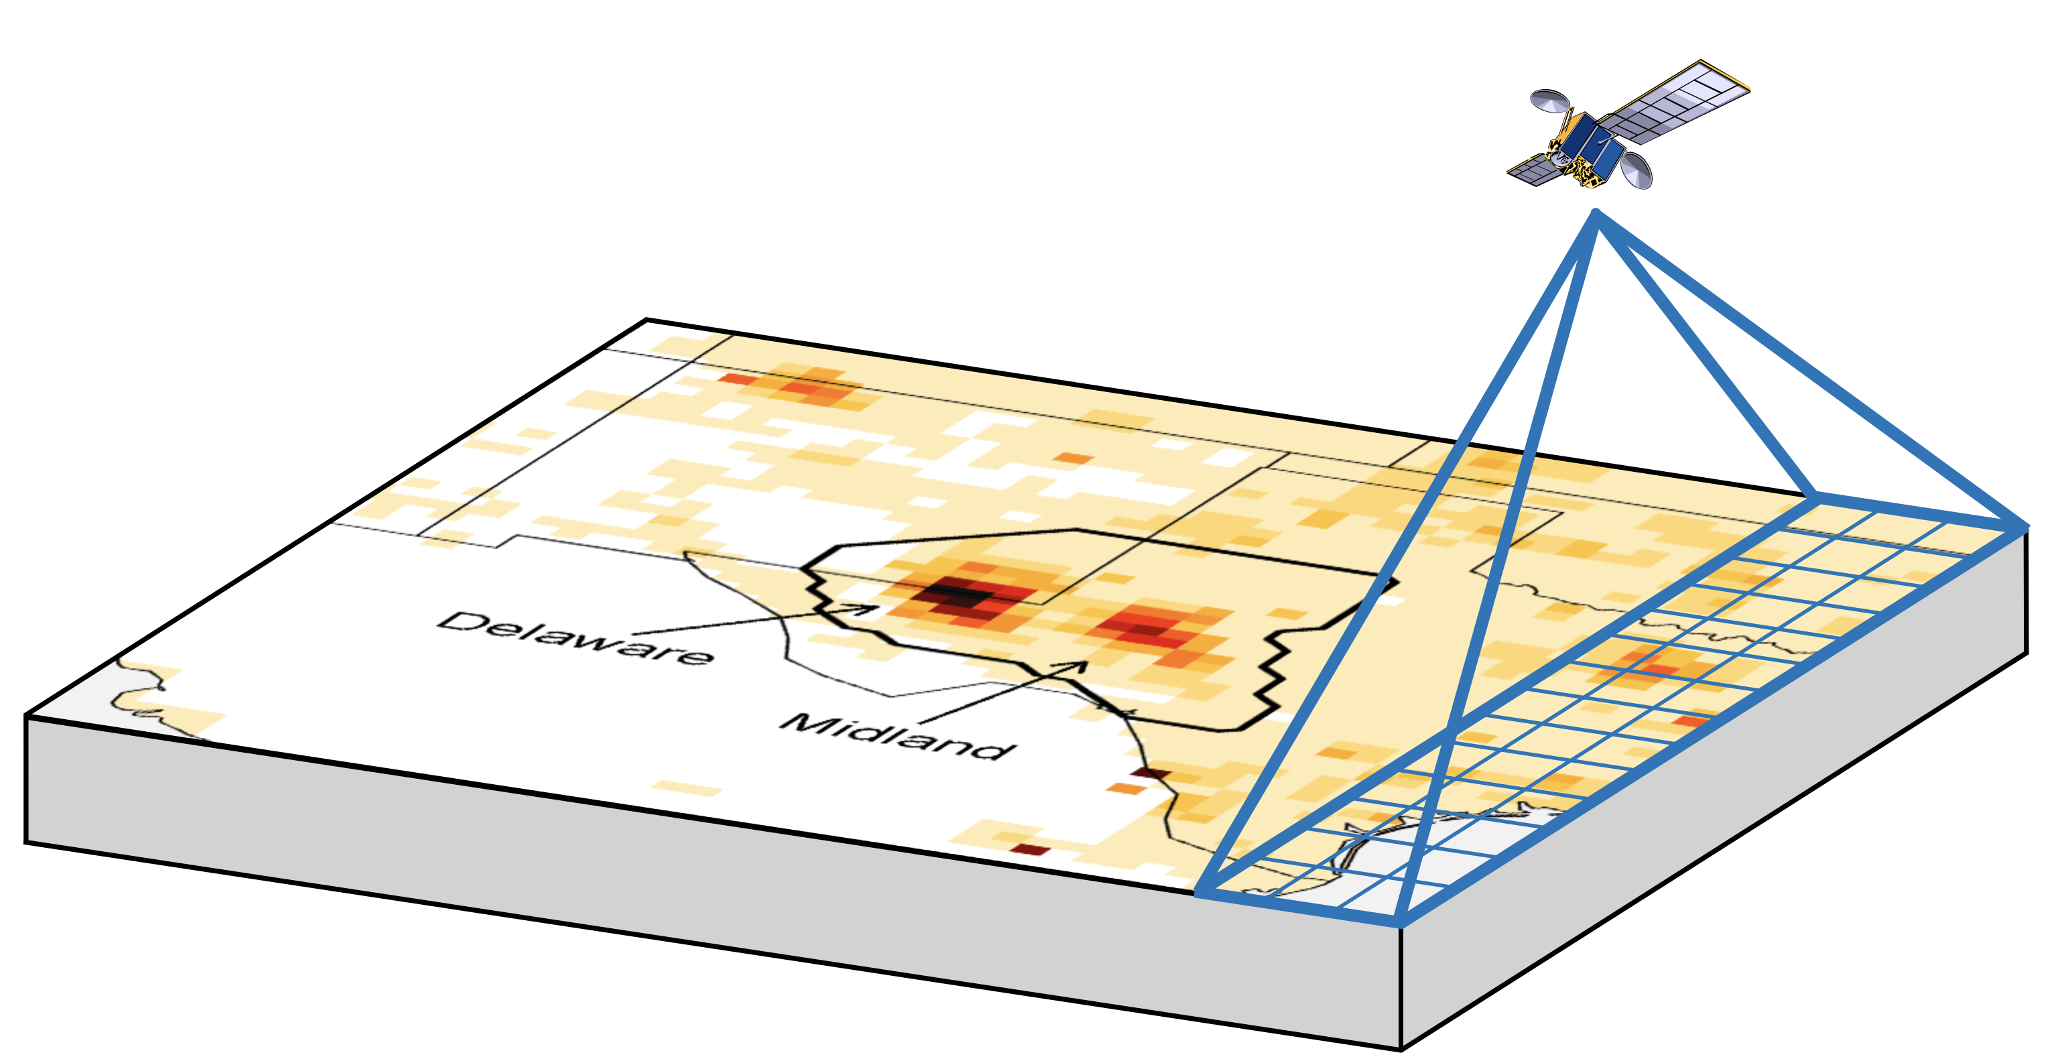
Integrated Methane Inversion (IMI): A tool for stakeholders to infer total methane emissions from satellite data
What IMI users can do:
Quantify methane emissions from any region at 25-km resolution with accounting of uncertainties
Compare their results to bottom-up emission inventories
Set up near-real-time continuous monitoring for their region
Run the IMI freely on the AWS cloud or with the user-friendly Integral Earth dashboard
What is under the IMI hood:
Advanced inverse methods documented in the scientific literature and made easy to use
A team of Harvard developers supported by NASA, Exxon-Mobil, and the Harvard Methane Initiative
An open-source code for transparency of results
Varon, D.J., et al., Integrated Methane Inversion (IMI 1.0): a user-friendly, cloud-based facility for inferring high-resolution methane emissions from TROPOMI satellite observations, Geosci. Model Dev. 15, 5787-5805,
https://doi.org/10.5194/gmd-15-5787-2022, 2022

Slide 2
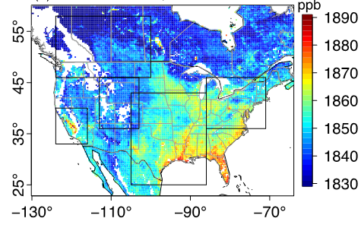
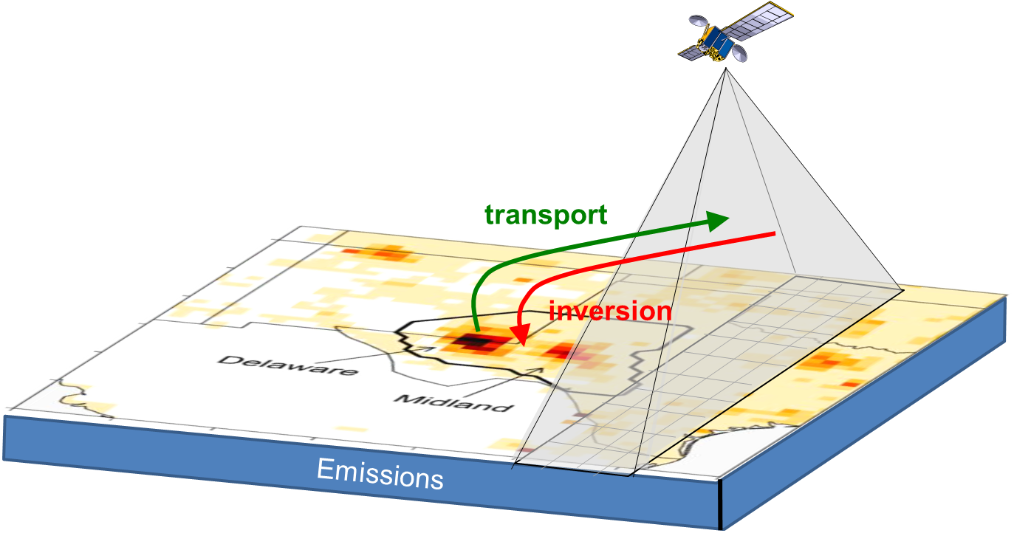
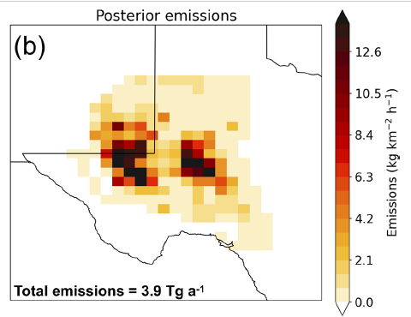
Satellites observe atmospheric methane worldwide, but calculating emission rates (through “inversions” of the satellite data) requires advanced computational resources and scientific expertise.
Why the IMI?
Satellites observe methane concentrations
TROPOMI
Point sources
IMI uses an analytical Bayesian inverse method backed up by a large body of scientific literature
It exploits data from TROPOMI and point source satellite instruments
All data processing is done on the cloud and is transparent to the user
Terabytes of data
Atmospheric transport model and inverse methods infer emissions from the observed concentrations
IMI output includes calculated emissions and their uncertainties, breakdown by sectors, comparison to previous inventories, point source information, etc.

Slide 3


The IMI puts the power of satellite data in the hands of non-expert stakeholders
Sustained R&D by Harvard group
Stakeholders
National, state, local govt agencies worldwide
International organizations
Industry
NGOs and advocacy groups
+
Actionable, total emissions data
Open-source data and code on the cloud ensure
Transparency
Reproducibility
Credibility
Select region and period of interest with simple configuration file

Slide 4
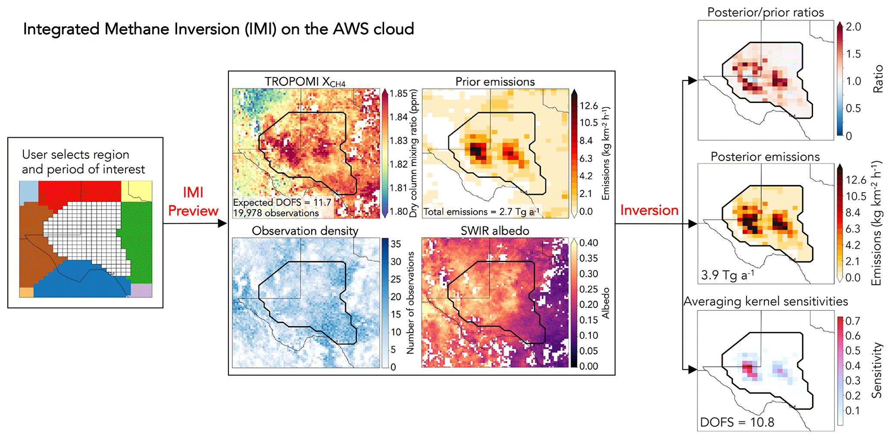
Free IMI preview lets user check satellite data quality first
IMI Preview
IMI preview tells user how much information to expect and the cost* of the inversion
*Reach out for accurate estimates. Costs range from $10 to $100+ per request depending on the region and period of interest.

Slide 5
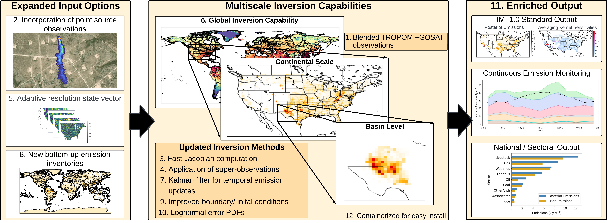
New IMI 2.0 released in June 2024 features greatly expanded capabilities
Improve user dashboard for ease of input and output management
Exploit new satellite datasets (MethaneSAT, Carbon Mapper, …)
Increase resolution to 12 km
Extend capability to CO₂
Future Developments:

Slide 6
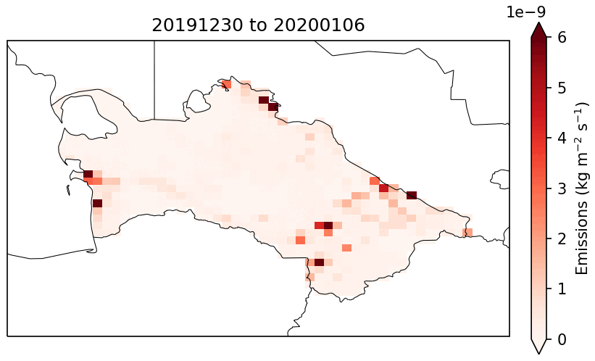
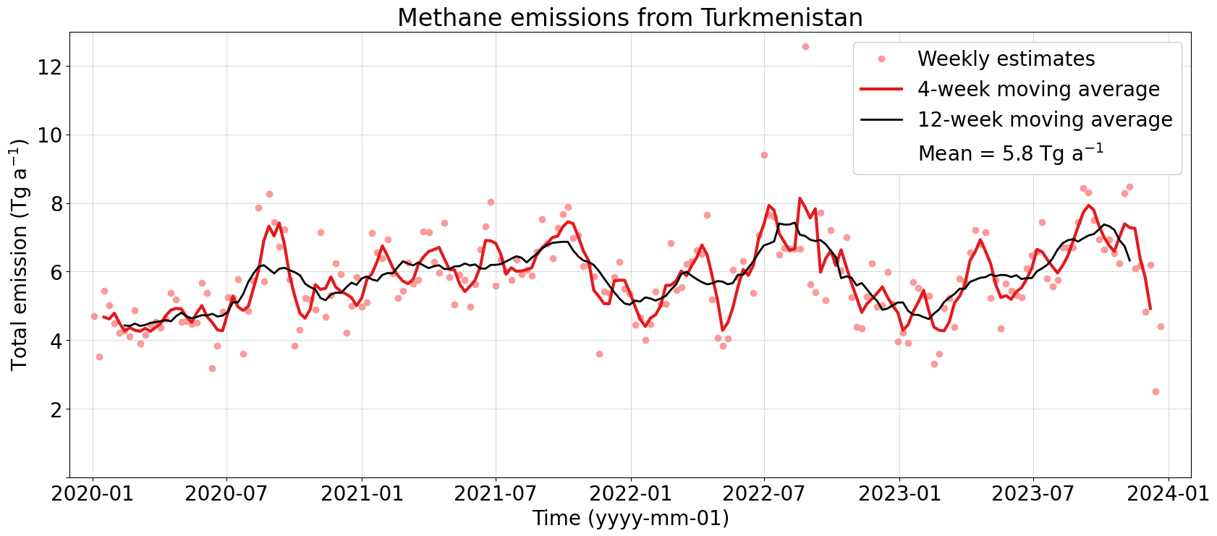
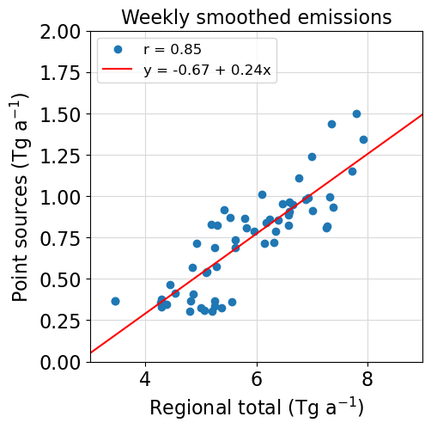
Continuous weekly monitoring of Turkmenistan’s methane emissions with IMI 2.0
IMI 2.0 enables continuous monitoring (e.g.,weekly, monthly) of methane emissions from any region of interest
Example: Continuous weekly monitoring of Turkmenistan’s methane emissions supports diplomatic activities of the UNEP International Methane Emissions Observatory (IMEO)
National total methane emissions are highly correlated with sums of point source detections in Turkmenistan (bottom right figure)

Slide 7
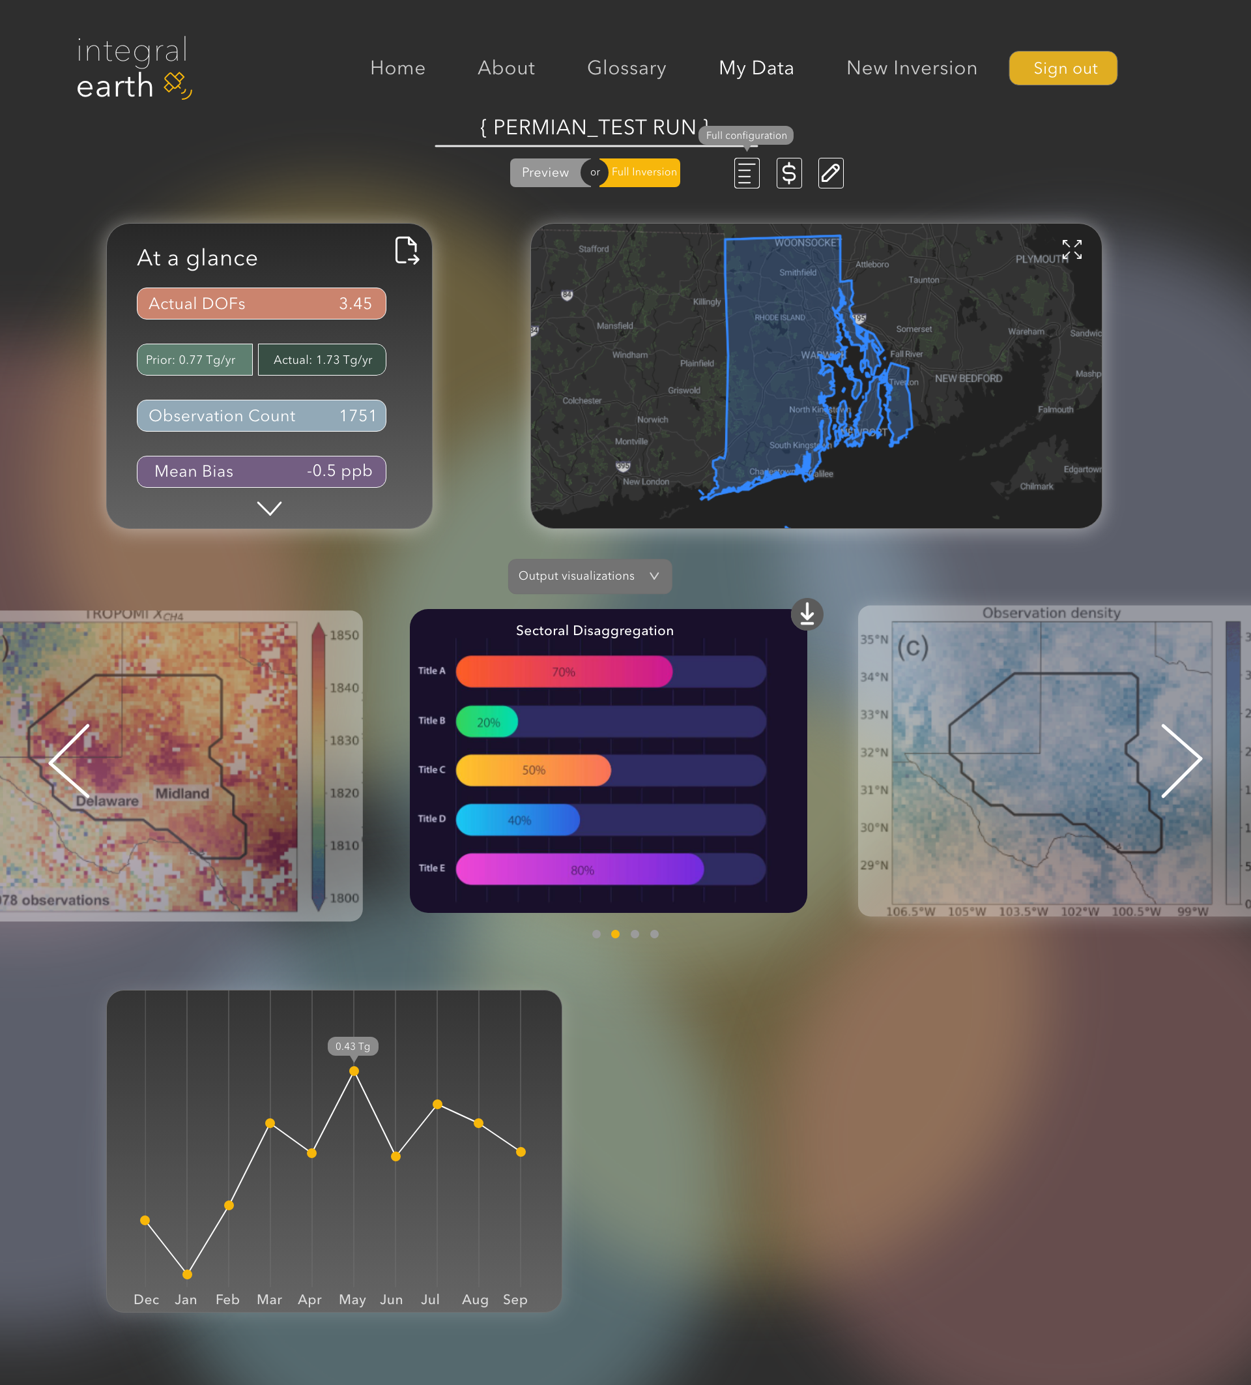
Coming soon… Integral Earth
Managed emission monitoring for easy stakeholder access via web UI
Expert evaluation of results
Customized emissions intelligence dashboards

Slide 8
To get more information and access the IMI:
The IMI is openly accessible on the AWS Marketplace. All you need is an AWS account: read the documentation at https://imi.readthedocs.io/en/dev/
Visit the IMI website: https://www.imi.seas.harvard.edu
Contact the IMI team:
Lucas Estrada (lestrada@g.harvard.edu, Lead Developer)
Melissa Sulprizio (mpayer@seas.harvard.edu, Software Engineer)
John Thomas (johnthomas@g.harvard.edu, Web Developer)
Alex Goodman (agoodman@mba2025.hbs.edu, Marketing Director)
Daniel Varon (danielvaron@g.harvard.edu, Lead Developer)
Daniel Jacob (djacob@fas.harvard.edu, Lab Director)
Attend virtual user workshop on 15 October 2024 at 11-13 eastern US time – contact Melissa Sulprizio to get on email list for updates

